Slide 1

Computer Networking CCNA 200-301

Slide 2
Course Outline
Module 1 Network Fundamentals
Explain Role and Function of Network Components : Routers, Switches, Firewall, IPs, WLC, AP, Endpoints, Servers
OSI Reference Model and TCP/ IP Model
IPv4 Addressing and Subnetting
IPv6 Addressing and IPv6 address Types
Module 2 Basic Configuration of Router and Lan Switching
Modes of Router
Basic Security of Router (Passwords) and Configuration of IP on Router
Point to Point connectivity of Routers
Configure and Verify Layer2 Discovery Protocols (CDP and LLDP)
Basic Operation of Switch (Collision Domain and Broadcast Domain)
Spanning-tree Protocol (PVST, RSTP), Port states and Port fast
Configure and Verify VLANS and Inter-switch Connectivity (Trunk ports, 802.Iq)
Ether-channel
Cisco Wireless Architecture and AP modes
Configuration of Wireless Lan Controller and AP Using GUI (WPA, WPA2, PSK)

Slide 3
Course Outline
Module 3 IP Routing
Static Routing with IPv4 and IPv6, floating static route and Default route
Configure and Verify Single area OSPF
DR and BDR election. Point to point, Concept of Router-ID
Module 4 IP Services
NAT
Configure and Verify NTP
Describe DNS, SNMP, Syslog, QOS, Function of FTP and TFPF in network
Configuration of DHCP, telnet and SSH
Describe the function of First hop redundancy protocol (HSRP, VRRP, GLBP)

Slide 4
Course Outline
Module 5 Security Fundamentals
Configure and Verify Access control List
Describe VPN Technologies (Site-to-site VPN and Remote access VPN)
Describe Authentication, Authorization and Accounting (AAA)
Configure Port Security, DHCP Snooping and Dynamic ARP Inspection
Module 6 Automation and Programmability
Explain how automation impacts network management
Compare traditional network with controller-based networking
Compare traditional campus device management with Cisco DNA Center enabled device Management.

Slide 5
Module 2 Basic Configuration of Router and Lan Switching
Modes of Router
Basic Security of Router (Passwords) and Configuration of IP on Router
Point to Point connectivity of Routers
Configure and Verify Layer2 Discovery Protocols (CDP and LLDP)
Basic Operation of Switch (Collision Domain and Broadcast Domain)
Spanning-tree Protocol (PVST, RSTP), Port states and Port fast
Configure and Verify VLANS and Inter-switch Connectivity (Trunk ports, 802.Iq)
Ether-channel
Cisco Wireless Architecture and AP modes
Configuration of Wireless Lan Controller and AP Using GUI (WPA, WPA2, PSK)
Telnet and SSH

Slide 6
How to Connect a Router/Switch with a PC/Laptop
1. Physical Connectivity
Connect the laptop and router using a console cable
Laptop ----- console cable ----- Router/Switch
2. Logical Connectivity
Use software or applications to establish a connection, such as:
Secure CRT
3COM
PuTTY
X-shell
HyperTerminal
At the CCNA level, HyperTerminal is commonly used.
Download and install the HyperTerminal

Slide 7
How to Connect a Router/Switch with a PC/Laptop
Note:
First, you need a physical connection to the router using a console cable.
Once connected physically, you can assign IP addresses to the router.
Without assigning IPs, you cannot configure the router logically.
After the IP addresses are configured, you can manage the router logically using software like PuTTY, HyperTerminal, or SSH.

Slide 8
How to Connect a Router/Switch with a PC/Laptop
Physical Connectivity:
Establish a connection using a console cable between the laptop and the router.
Use software like HyperTerminal or PuTTY to access the router's CLI.
Assign IP Addresses ,Configure an IP address on the router via the console connection.
Logical Connectivity:
Once IP addresses are configured, you can manage the router remotely.
Use software like PuTTY, SSH, or Telnet for remote access to the router's CLI.

Slide 9
How to Connect a Router/Switch with a PC/Laptop
1. Physical Connectivity
Connect the laptop and router using a console cable
Laptop ----- console cable ----- Router/Switch
Software for Connectivity:
HyperTerminal
(or other terminal software like PuTTY)
Steps of HyperTerminal
Install HyperTerminal
Open HyperTerminal.
Name the connection (e.g., Router Connection).
Select the COM port (e.g., COM1, COM2) assigned to your console cable.
Configure Serial Settings:
Baud Rate: 9600
Data Bits: 8
Parity: None
Stop Bits: 1Flow Control: None
Click OK to establish the connection.

Slide 10
Modes of Routers
1. User EXEC Mode
Prompt: Router>
Purpose: Basic diagnostics, limited commands available.
? shows available commands in this mode.
2.Privileged EXEC Mode (Enable Mode)
Prompt: Router#
Purpose: Access to advanced commands and router configurations.
To Enter:
Router> enable
Router#
? shows all available commands in this mode.
3. Global Configuration Mode
Prompt: Router(config)#
Purpose: Configure global parameters, interfaces, and routing protocols.
To Enter:
Router> enable
Router# configure terminal
Router(config)#
? shows available commands in this mode.

Slide 11
Some Basic Configuration
How to change CISCO Router name?
We can change CISCO router name in Global mode
Router> enable
Router#
Router# configure terminal
Router(config)#
Router(config)# hostname MyRouter
MyRouter(config)#
How to Set Date & Time on CISCO Router?
In Enable/Privilege mode we can set clock
Router# show clock
➔ this will show default clock set by CISCO company
Router# clock set ?
Router# clock set 01:18:30 ?
Router# clock set 01:18:30 26 Dec ?
Router# clock set 01:18:30 26 Dec 2024
Now check it
Router# show clock

Slide 12
Some Basic Configuration
How to set Banner on CISCO Router?
Message of the Day (MOTD) Banner
It’s displayed when a user connects to the router via SSH, Telnet, or console.
Router(config)#
Router(config)#banner motd # Welcome #
How to Configure Password on Line Console?
Configuring a password on the console line restricts physical access to the router's command-line interface (CLI) via the console port.
Router> enable
Router# configure terminal
Router(config)#
Router(config)# line console 0
Router(config-line)# password cisco123
Router(config-line)# login
Router(config-line)# exit
To remove the password
Router(config)# line console 0
Router(config-line)# no password
Router(config-line)# no login
Router(config-line)# exit

Slide 13
Some Basic Configuration
How to Configure password on line AUX?
Purpose of AUX Line:
The AUX line is used for remote access via a modem or other remote access methods.
It allows administrators to access the router remotely through a dial-up connection.
Router> enable
Router# configure terminal
Router(config)# line aux 0
Router(config-line)# password 12345
Router(config-line)# login
Router(config-line)# exit
To remove it:
Router> enable
Router# configure terminal
Router(config)# line aux 0
Router(config-line)# no password
Router(config-line)# no login
Router(config-line)# exit

Slide 14
Some Basic Configuration
How to Configure password on line VTY?
VTY Stands for Virtual Teletype
These are virtual terminals lines used for remote access to the device (via Telnet or SSH
Purpose of VTY Line:
The VTY line is used for remote access to the router via protocols such as Telnet or SSH.
It allows administrators to connect remotely from a terminal or network device.
Router> enable
Router# configure terminal
Router(config)# line vty 0 4
Router(config-line)# password 12345
Router(config-line)# login
Router(config-line)# exit
To remove it :
Router> enable
Router# configure terminal
Router(config)# line vty 0 4
Router(config-line)# no password
Router(config-line)# no login
Router(config-line)# exit
These are the default 5 VTY lines on most Cisco devices.
0 4 means you're configuring 5 remote access lines (0 to 4) used for Telnet or SSH. It allows up to 5 people to connect to the device at the same time.

Slide 15
Some Basic Configuration
How to Configure password on enable mode?
Purpose of Enable Mode Password:
The enable mode password is used to secure access to privileged EXEC mode.
It ensures that only authorized users can access the more advanced configuration commands.
Router> enable
Router# configure terminal
Router(config)# enable password 12345
To remove it :
Router> enable
Router# configure terminal
Router(config)# no enable password

Slide 16
Some Basic Configuration
How to Configure enable secret password ?
Purpose of Enable Secret Password:
The enable secret password secures privileged EXEC mode access on a Cisco router.
It is encrypted in the configuration file, making it more secure than the plain-text enable password.
Router> enable
Router# configure terminal
Router(config)# enable secret abc123
To remove it :
Router> enable
Router# configure terminal
Router(config)# no enable secret
The enable secret password takes precedence over the enable password.
It is stored in an encrypted format, unlike the enable password.

Slide 17
Some Basic Configuration
How to convert all the password to encrypted form?
Purpose :
To protect all plain-text passwords (e.g., line passwords, enable passwords) in the router's configuration file.
Prevent unauthorized users from viewing passwords in plain text when accessing the configuration file.
Router> enable
Router# configure terminal
Router(config)# service password-encryption
Check the result :
Router# show running-config
To remove it :
Router> enable
Router# configure terminal
Router(config)# no service password-encryption
Command: service password-encryption
Encryption type: Type 7 (weak reversible XOR cipher)Purpose: Obfuscation only (not secure)
To Save the configuration
Router# copy running-config startup-config

Slide 18
Viewing and Saving Configuration on a Cisco Router
To see the current (running) configuration:
Router# show running-config
This displays the configuration currently in use by the router.
To see the saved (startup) configuration:
Router# show startup-config
This displays the configuration stored in NVRAM, which is loaded when the router starts.
Saving the Configuration
Router# copy running-config startup-config
Shortcut Command:
Router# write memory
It Saves whatever is currently in RAM(Running-Config) into NVRAM (Startup-Config)

Slide 19
Resetting a Cisco Router to Factory Defaults
To Reset a Cisco Router:
Router> enable
Erase the Startup Configuration:
Router# write erase
Or
Router# erase startup-config
Router# reload

Slide 20
Resetting a Cisco Router to Factory Defaults
To Reset a Cisco Router if you forgot the line console passowrd:
Turn off your router and turn it on again , and interrupt the boot process by Press:
In Putty : ctrl+Break or ctrl+pause
In Tera term : Alt+B
In Packet tracer : ctrl +Break or ctrl+ Pause
You will see
rommon>

Slide 21
Resetting a Cisco Router to Factory Defaults
To Reset a Cisco Router if you forgot the line console passowrd:
Wha is ROMmon ?
ROMMon ➔ ROM Monitor , is a small program on cisco routers
It runs before IOS (the Router’s Operating system)
Think of it like the BIOS/Boot menu of a PC
You enter ROMmon when you interrupt the normal boot (by pressing ctrl+break)

Slide 22
Resetting a Cisco Router to Factory Defaults
To Reset a Cisco Router if you forgot the line console passowrd:
rommon> confreg 0x2142
rommon> reset
confreg 0x2142 ➔ tells the router , ignore the saved startup configuration when you boot
This means ignore passwords, IPs, routing etc stored in NVRAM.
reset ➔ Reboots the router with that setting
This does not wipe/erase NVRAM , it only tells the router ignore the startup-config in NVRAM while booting
After the boot if you run , copy startup-config running config
You will get all your old config back (including old passwords)

Slide 23
Resetting a Cisco Router to Factory Defaults
To factory reset completely wipe everything in NVRAM :
rommon> confreg 0x2142
rommon> reset
After booting
Router > enable
Router > write erase
Router #erase startup-config
Router Reload
NVRAM is cleared , no Password, No IP , No protocols

Slide 24
Resetting a Cisco Router to Factory Defaults
If you want to Clear the Passwords only , and keep other configurations there.
rommon> confreg 0x2142
rommon> reset
Router> enable
Router# copy startup-config running-config
Router(config)# no enable password
Router(config)# no enable secret
Router(config)# line console 0
Router(config-line)# no password
Router(config-line)#
Router(config-line)# no login
Router(config-line)# exit
Router(config)# config-register 0x2102
Router# write memory
Bring your full configuration (IPs , Routing Protocols etc into RAM
✅ End result:
All IPs, routing, protocols remain.
Only passwords are reset.
Restore boot setting

Slide 25
How to Assign IP to Router Interface
LAN Interface
Router> enable
Router# configure terminal
Router(config)# interface fa0/0
Router(config-if)# ip address 192.168.1.1 255.255.255.0
Router(config-if)# no shutdown
Router(config-if)# exit
Verify the Configuration:
Router# show ip interface brief
WAN Interface
Router> enable
Router# configure terminal
Router(config)# interface s0/0/0
Router(config-if)# ip address 1.1.1.1 255.0.0.0
Router(config-if)# no shutdown
Router(config-if)# exit
Verify the Configuration:
Router# show ip interface brief

Slide 26
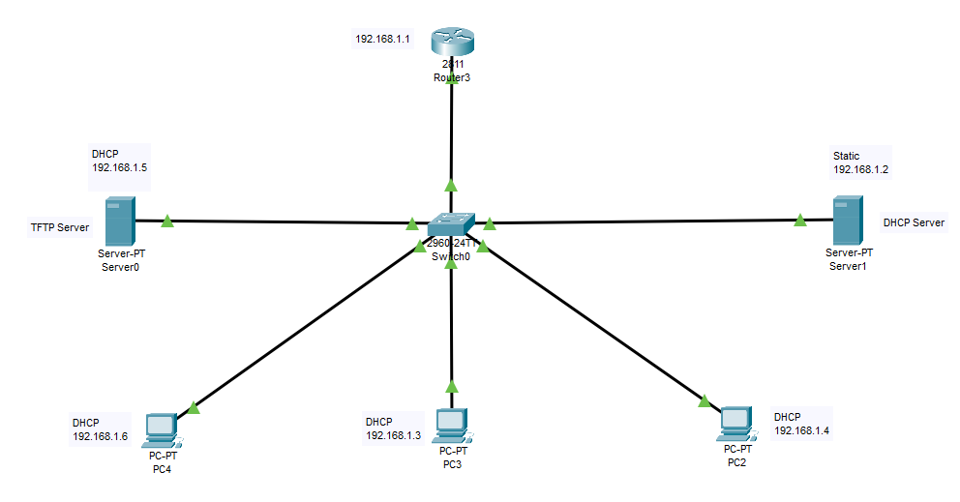
Backup of Cisco Router Configuration
Backup to a TFTP Server:
Router> enable
Router# copy running-config tftp
Router# copy startup-config tftp
Restore Configuration
Router# copy tftp running-config
Router# copy running-config startup-config
Address or name of remote host [ ]? 192.168.1.5
Source filename [ ]? myconfiguration
Press Enter to accept the default (running-config) when prompted:
Destination filename [running-config]?

Slide 27
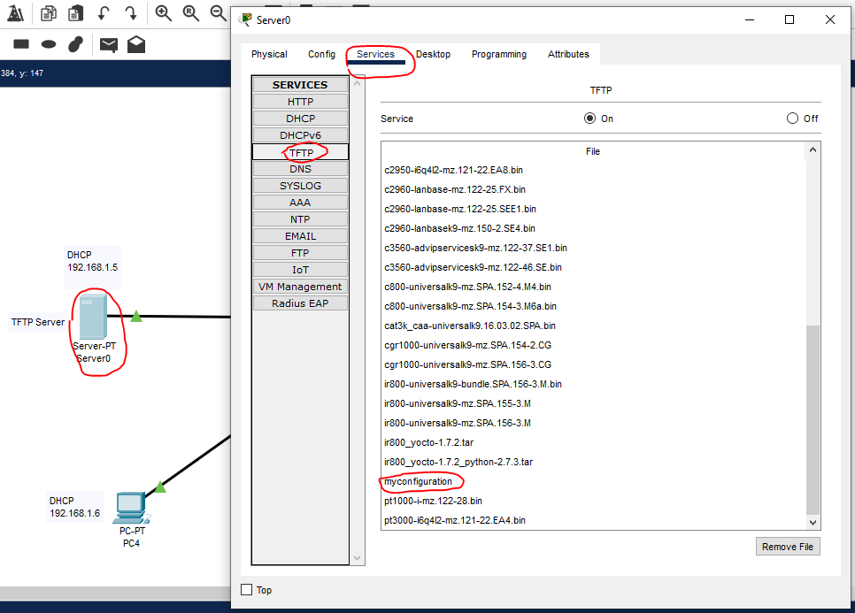
Steps to View Files on the TFTP Server in Packet Tracer
Click on the TFTP server in your network diagram.
Once the TFTP server device window opens, go to the Services tab.
From the left menu, click on TFTP under Services.
A list of saved files will appear in the right panel
Find out the one which you have saved

Slide 28
Backup of Cisco Router Configuration
Backup to a Flash Drive
Save Configuration to Router's Flash:
Router# copy running-config flash:backup-config
Transfer the File via USB (If Supported):
If your router supports USB storage, connect the USB and copy the file:
Router# copy flash:backup-config usbflash0:
usbflash0: is the default storage location of the USB device.
Restore backup from USB
Router> enable
Router# copy usbflash0:backup-config running-config
Router# copy running-config startup-config

Slide 29
Backing Up Configuration to a Local File via Terminal (Text File)
Backup Saved a Text File
Router> enable
Router# copy running-config flash:backup-config.txt
This saves the running-config to a text file (backup-config.txt) on the router's flash memory.
Verify the Backup File Exists:
Router# dir flash:backup-config.txt
To Restore:
Router> enable
Router# copy flash:backup-config.txt running-config

Slide 30
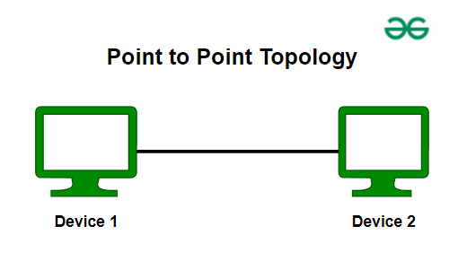
Point-to-Point Connectivity (Router to Router)
Refers to a direct, dedicated connection between two network devices (routers, switches, or PCs) using a single communication link. This link allows devices to communicate directly and efficiently.
A single, dedicated communication link connects two routers.
No other devices share this link.
Advantages of Point-to-Point Connectivity:
High-speed, dedicated link.
Simplified routing configuration.
Reliable communication between two points.

Slide 31
Telnet
A protocol used for remote access to network devices (e.g., routers, switches).
Operates over TCP port 23.
Features:
Provides command-line interface access.
Allows configuration and troubleshooting remotely.
Plaintext transmission (less secure).
Steps to Enable Telnet on Cisco Routers:
Router(config)# line vty 0 4
Router(config-line)# password 123
Router(config-line)# login
Router(config-line)#exit
Router(config)# enable secret 1234
To Check the Result:
Go to a PC and open the Command Prompt.
C:\> telnet 192.168.1.1
You will get access to the router's command-line interface. From there, you can perform all configurations directly from the computer.

Slide 32
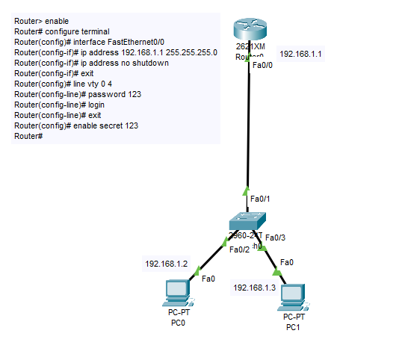
Telnet
Go to a PC and open the Command Prompt.
C:\> telnet 192.168.1.1
You will get access to the router's command-line interface. From there, you can perform all configurations directly from the computer.

Slide 33
SSH
SSH, or Secure Shell, is a protocol that allows secure remote access to devices over a network.
It encrypts communication to prevent eavesdropping and ensures data is protected and confidential.
SSH is preferred because it provides encryption and authentication, making it much more secure than older protocols like Telnet.
Telnet sends data in plain text, which can be intercepted, while SSH encrypts all data, protecting it from attackers.
It operates on port 22 by default.

Slide 34
SSH
SSH Configuration Steps:
Define Username and Password:
Configure a username and password for SSH access. Also, set an enable secret for privileged mode access.
Define Domain Name:
Set the domain name (typically the organization’s name) for SSH configuration.
Define Crypto Key:
Generate a crypto key pair for encryption. This key is used for secure communication over SSH.
Apply SSH on VTY Lines:
Enable SSH access on the VTY (Virtual Terminal) lines for remote management.
Verify SSH Configuration:
Check the SSH configuration to ensure it is working correctly.
Summary
Set username and password + enable secret.
Define the domain name (organization name).
Generate crypto key for encryption.
Apply SSH on VTY lines.
Verify SSH configuration.

Slide 35
SSH
Practical:
Router(config)# hostname Corvit
Corvit(config)# username corvit password 123
Corvit(config)# enable secret 123
Corvit(config)# ip domain-name covit.com
Corvit(config)# crypto key generate rsa general-keys modulus 2048
Corvit(config)# line vty 0 4
Corvit r(config-line)# login local
Corvit(config-line)# transport input ssh
Corvit # show ip ssh
Corvit # show running-config
Username and Password and enable secret
Define Domain Name
Generate Crypto Key
Enable SSH on VTY Line
Verify SSH Configuration

Slide 36
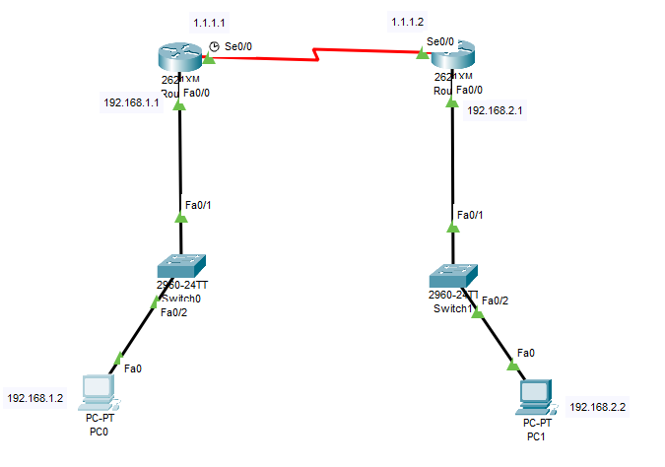
SSH
Practical:
Router# configure terminal
Router(config)# interface fa0/0
Router(config-if)# ip address 192.168.1.1 255.255.255.0
Router(config-if)# no shutdown
Router(config-if)# exit
Router(config)# hostname Corvit
Corvit(config)# username corvit password 123
Corvit(config)# enable secret 123
Corvit(config)# ip domain-name covit.com
Corvit(config)# crypto key generate rsa general-keys modulus 2048
Corvit(config)# line vty 0 4
Corvit r(config-line)# login local
Corvit(config-line)# transport input ssh
Corvit # show ip ssh
Corvit # show running-config
Go to PC
C:\> ssh -l corvit 192.168.1.1

Slide 37
SSH
Configure SSH on another router in the same way, follow the steps, and then you can access any router from the PC.
C:\> ssh -l username router-ip

Slide 38
Configure and Verify Layer 2 Discovery Protocols (CDP and LLDP)
CDP (Cisco Discovery Protocol) | LLDP (Link Layer Discovery Protocol)
Cisco Proprietary | Open Standard
Enabled by default | Disabled by default
Update Time 60 seconds | Update Time 30 seconds
Hold Time 180 seconds | Hold Time 120 seconds

Slide 39
CDP
Cisco Discovery Protocol (CDP) is a proprietary Layer 2 protocol used by Cisco devices to discover and share information about directly connected devices. It operates over the data link layer (Layer 2 of the OSI model), meaning it doesn’t rely on IP addresses.
Run by default on CISCO (Routers & Switches)
Neighbor Discovery:
Automatically discovers directly connected Cisco devices, such as routers, switches, and phones.
Provides details about neighboring devices without manual configuration.
Device Information Sharing:
Device IDs (e.g., hostname).
Interface details (e.g., port numbers).
Platform (e.g., router or switch model).
IP addresses (in detailed output).

Slide 40
CDP
Network Troubleshooting:
Helps identify misconfigurations or issues in physical connectivity.
Verifies which devices are connected and how.
Voice and Data Integration:
Useful in VoIP environments to identify IP phones connected to switches.
Building Network Diagrams:
Gathers topology details for documentation or network planning.
How CDP Works:
CDP-enabled devices send advertisements to directly connected devices.
Advertisements contain the device's information.
The default advertisement interval is 60 seconds.
CDP information is stored in a CDP table, which can be viewed using :
#show cdp neighbors
#show cdp neighbors details

Slide 41
CDP
Dis-Advantages of CDP:
Security Issues
Bandwidth Consumptions (CDP Packets use bandwidth. Every 60 seconds it updates
How to disable CDP:
configure terminal
no cdp run
How to enable CDP
configure terminal
cdp run

Slide 42
LLDP
LLDP (Link Layer Discovery Protocol):
LLDP is an open standard Layer 2 protocol used for discovering and sharing information about directly connected devices, similar to Cisco's CDP but vendor-neutral.
By default, LLDP is disabled on Cisco devices. To enable it:
To enable it :
configure terminal
lldp run
To View the Details:
show lldp neighbors detail
How to Disable it
Router(config)# no lldp run

Slide 43
How to enable CDP and LLDP on Specific Interface
CDP
Router(config)# interface fa0/1
Router(config-if)# cdp enable
Router(config-if)# exit
Router# show cdp interface fa0/1
LLDP
Router(config)# interface fa0/1
Router(config-if)# lldp transmit
Router(config-if)# lldp receive
Router(config-if)# exit
Router# show lldp neighbors

Slide 44
Switch
A network switch is a device that connects multiple devices within a LAN for efficient communication.
Core Function: Forwards data to the correct device using MAC addresses.
Switch creates and maintains a MAC address table (also called a forwarding table or CAM table) .CAM stands for Content Addressable Memory table.
MAC Address Table (Switch) Enables the switch to forward frames to the correct destination.
All ports on a switch that connect to end devices (e.g., computers, printers) are referred to as access ports, and their associated connection is called an access link.
Ports that connect two switches are known as trunk ports, and their connection is referred to as a trunk link.
#Show mac address table

Slide 45
Some Basic Configurations
Change Hostname
switch(config)# hostname myswitch
Set Console Line Password
switch(config)# line console 0
switch(config-line)# password 123
switch(config-line)# login
switch(config-line)# exit
Set Enable Secret Password
switch(config)# enable secret 123
Set VTY (Telnet/SSH) Line Password
switch(config)# line vty 0 4
switch(config-line)# password 123
switch(config-line)# login
switch(config-line)# exit
switch(config)# enable secret 123

Slide 46
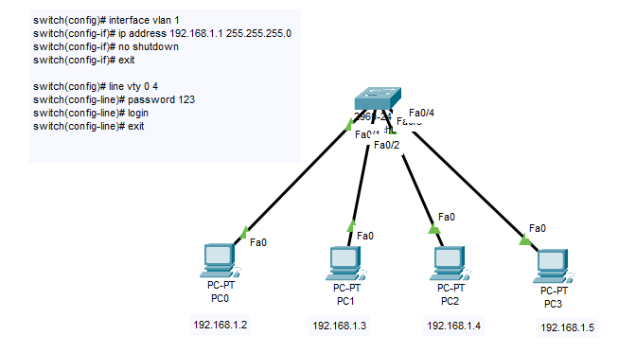
Some Basic Configurations
To Remotely Access a Switch using Telnet
switch(config)# interface vlan 1
switch(config-if)# ip address 192.168.1.1 255.255.255.0
switch(config-if)# no shutdown
switch(config-if)# exit
switch(config)# line vty 0 4
switch(config-line)# password 123
switch(config-line)# login
switch(config-line)# exit
switch(config)# enable secret 123
Test Remote Access
Go to a PC and open the Command Prompt.
C:\> telnet 192.168.1.1
You will get access to the Switch's command-line interface. From there, you can perform all configurations directly from the computer.

Slide 47
Some Basic Configurations
To Remotely Access a Switch using SSH
switch(config)# interface vlan 1
switch(config-if)# ip address 192.168.1.1 255.255.255.0
switch(config-if)# no shutdown
switch(config-if)# exit
switch(config)# hostname Corvit
Corvit(config)# username corvit password 123
Corvit(config)# enable secret 123
Corvit(config)# ip domain-name corvit.com
Corvit(config)# crypto key generate rsa general-keys modulus 2048
Corvit(config)# line vty 0 4
Corvit(config-line)# login local
Corvit(config-line)# transport input ssh
Corvit(config-line)# exit
Test Remote Access
Go to PC
C:\> ssh -l corvit 192.168.1.1

Slide 48
IP assigning to Switch
You cannot directly assign an IP address to physical switch ports like you would on a router.
The IP configuration is applied to the VLAN interfaces (like VLAN 1) to manage the switch itself
Even a Layer 3 switch can route between VLANs using interfaces configured with IP addresses.
Ports are assigned to VLANs, and IP addresses are applied to VLAN interfaces, not individual physical switch ports.
IP Addressing in a Layer 3 Switch:
You configure IP addresses on VLAN interfaces.
These VLAN interfaces act like router interfaces and handle routing between VLANs.
Port Configuration:
Switch ports are typically assigned to VLANs, and VLAN interfaces have IP addresses.
Traffic between VLANs is routed through these VLAN interfaces

Slide 49
IP assigning to Switch
On a Layer 3 switch, you can assign IP addresses in two ways:
🔹 1. To VLAN Interfaces (SVIs):SVI stands for Switched Virtual Interface
This is the standard method.
You assign an IP to a VLAN, then put ports into that VLAN.
Router> enable
Router# configure terminal
Router(config)# interface vlan 10
Router(config-if)# ip address 192.168.10.1 255.255.255.0
Router(config-if)# no shutdown
Router(config-if)# exit
Router(config)# interface GigabitEthernet0/1
Router(config-if)# switchport mode access
Router(config-if)# switchport access vlan 10
Router(config-if)# exit
Router#
You can assign an IP to a physical port on a Layer 3 switch if you use no switchport. Or, use VLANs and assign IPs to SVIs

Slide 50
IP assigning to Switch
On a Layer 3 switch, you can assign IP addresses in two ways:
🔹 2. To Physical Ports (Like a Router):
You can convert a switch port into a routed port and assign it an IP directly.
This works because Layer 3 switches support routing.
But only after you enable:
Router> enable
Router# configure terminal
Router(config)# interface GigabitEthernet0/2
Router(config-if)# no switchport
Router(config-if)# ip address 192.168.20.1 255.255.255.0
Router(config-if)# no shutdown
Router(config-if)# exit
Router(config)# exit
Router#
You can assign an IP to a physical port on a Layer 3 switch if you use no switchport. Or, use VLANs and assign IPs to SVIs

Slide 51
What is VLAN
VLAN: Virtual Local Area Network
Logical segmentation of a network into smaller, isolated parts.
Operates at Layer 2 (Data Link) of the OSI model.
Devices in the same VLAN act as if they are on the same physical network.
MAC Address Table (Switch) Enables the switch to forward frames to the correct destination.
Key Benefits
Improves Security: Isolates sensitive data.
Boosts Performance: Reduces unnecessary ,broadcast traffic.
Simplifies Management: Logical grouping instead of physical dependence.

Slide 52
What is VLAN
VLAN: Virtual Local Area Network
By default, all switch ports belong to VLAN 1.
VLAN 1 is also known as the native VLAN.
Devices in VLAN 1 can communicate with each other.
Devices within the same VLAN can communicate with each other.
Devices in different VLANs cannot communicate directly. To enable communication between different VLANs, inter-VLAN routing is required.
How to create
How to create VLAN?
How to assign ports to a VLAN?
How to assign multiple ports to a VLAN?
How to assign a specific port to a VLAN?
Conditions are VLANs
Both interfaces must be in trunk mode.
Encapsulation must match.
Allowed VLANs must match.
Native VLAN must match.
Even if a switch has 48 ports, you can still create up to 4094 VLANs because:
VLANs are logical, not limited by the number of physical ports.
Maximum VLANs: Up to 4094 VLANs on supported switch

Slide 53
How to create VLAN
switch(config)# vlan 10
switch(config-vlan)# name Sales
switch(config-vlan)# exit
How to assign port to VLAN
switch(config)# interface fa 0/1
switch(config-if)# switchport mode access
switch(config-if)# switchport access vlan 10
switch(config-if)# exit
How to assign Multiple ports to VLAN
switch(config)# interface range fa 0/1 - 24
switch(config-if-range)# switchport mode access
switch(config-if-range)# switchport access vlan 10
switch(config-if-range)# exit
How to assign multiple Specific ports to VLAN
switch(config)# interface range fa 0/1, 0/12, 0/18
switch(config-if-range)# switchport mode access
switch(config-if-range)# switchport access vlan 10
switch(config-if-range)# exit
How to Configure a Trunk Port
switch(config)# interface range fa 0/1, fa 0/2
switch(config-if-range)# switchport mode trunk
switch(config-if-range)# exit
Result:
Switch# show vlan
How to delete VLAN?
Switch# configure terminal
Switch(config)# no vlan 10
Switch(config)# end

Slide 54
Result:
Switch# show vlan
When you run show vlan on a Cisco switch, you’ll always see those extra VLANs (1002–1005).
VLAN 1002 (fddi-default) → for old fiber networks (FDDI).
VLAN 1003 (token-ring-default) → for old Token Ring networks.
VLAN 1004 (fddinet-default) → for old fiber networks with two rings.
VLAN 1005 (trnet-default) → for old Token Ring networks.
Back in the 80s–90s, some companies used FDDI or Token Ring instead of Ethernet.
They are not used anymore. Ethernet completely replaced them.
You’ll still see them on all Cisco switches, but they are just reserved placeholders, not active in real life.

Slide 55
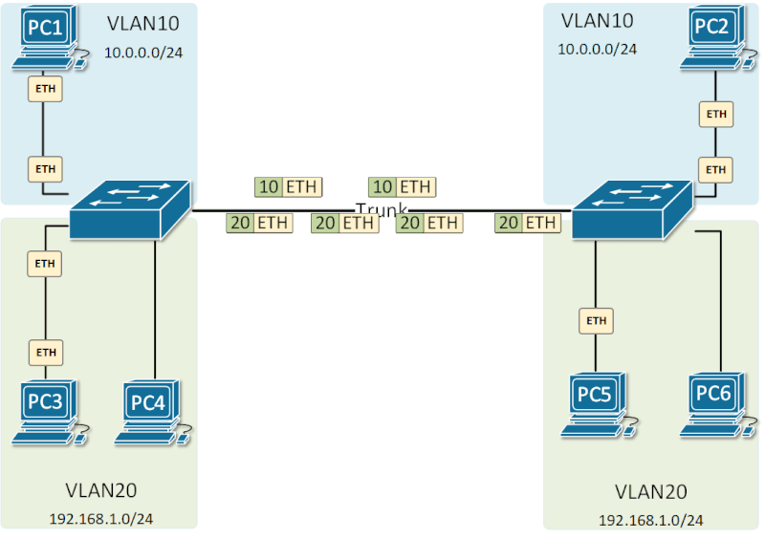

Slide 56
Trunk Links - ISL vs. 802.1Q (Dot1Q)
There are different types of trunk links. The most commonly used types are:
ISL (Inter-Switch Link):
A Cisco proprietary protocol that encapsulates the entire frame and adds VLAN information.
Encapsulation method used for VLAN tagging.
Inserts a 4-byte header & 4-byte FCS at the beginning of frames.
Supports up to 1000 VLANs.
Older, less commonly used
switch(config)# interface fa 0/5
switch(config-if)# switchport mode trunk
switch(config-if)# exit
IEEE 802.1Q Trunking:
Open Standardized VLAN Trunking Protocol
Adds VLAN tags to the Ethernet frames to carry traffic for multiple VLANs over the same link.
Inserts a 4-byte VLAN tag in the Ethernet frame, separating VLAN ID from the payload.
Supports up to 4096 VLANs.
More commonly used as it is vendor-independent.
Compatible with non-Cisco equipment.
switch(config)# interface fa 0/5
switch(config-if)# switchport mode trunk
switch(config-if)# switchport trunk encapsulation dot1q
switch(config-if)# exit
For IEEE use a multi layer switch in packet tracer

Slide 57
What is Encapsulation
Encapsulation refers to the process of wrapping data with additional information as it travels across a network.
In the context of VLAN Trunking :
Encapsulation is the technique used to insert VLAN identification into Ethernet frames so they can pass through trunk links.
Trunk links carry traffic for multiple VLANs, so encapsulation ensures that the data from different VLANs remains separated and identifiable.

Slide 58
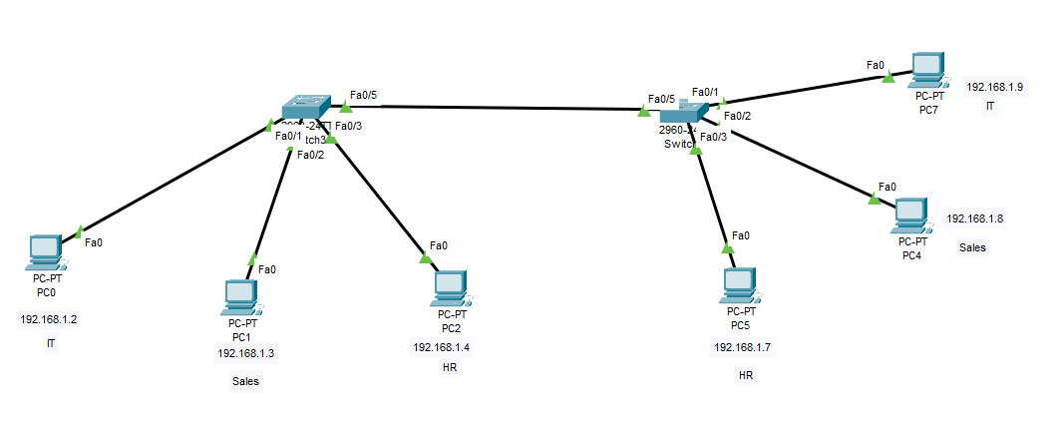
VLAN & Trunk Link Configuration Example:
Switch B
Access Link
Switch A
Trunk Link
Access Link
Access Link
Access Link
Access Link
Access Link

Slide 59
VLAN Configuration Example:
Switch A
switch(config)# vlan 10
switch(config-vlan)# name IT
switch(config-vlan)# exit
switch(config)# vlan 20
switch(config-vlan)# name HR
switch(config-vlan)# exit
switch(config)# vlan 30
switch(config-vlan)# name Sales
switch(config-vlan)# exit
switch(config)# interface fa 0/1
switch(config-if)# switchport mode access
switch(config-if)# switchport access vlan 10
switch(config-if)# exit
switch(config)# interface fa 0/2
switch(config-if)# switchport mode access
switch(config-if)# switchport access vlan 20
switch(config-if)# exit
switch(config)# interface fa 0/3
switch(config-if)# switchport mode access
switch(config-if)# switchport access vlan 30
switch(config-if)# exit
Switch B
switch(config)# vlan 10
switch(config-vlan)# name IT
switch(config-vlan)# exit
switch(config)# vlan 20
switch(config-vlan)# name HR
switch(config-vlan)# exit
switch(config)# vlan 30
switch(config-vlan)# name Sales
switch(config-vlan)# exit
switch(config)# interface fa 0/1
switch(config-if)# switchport mode access
switch(config-if)# switchport access vlan 10
switch(config-if)# exit
switch(config)# interface fa 0/2
switch(config-if)# switchport mode access
switch(config-if)# switchport access vlan 20
switch(config-if)# exit
switch(config)# interface fa 0/3
switch(config-if)# switchport mode access
switch(config-if)# switchport access vlan 30
switch(config-if)# exit
Now you need Configure trunk (ISL) on both switches
Switch A
switch(config)# interface fa 0/5
switch(config-if)# switchport mode trunk
switch(config-if)# exit
Switch B
switch(config)# interface fa 0/5
switch(config-if)# switchport mode trunk
switch(config-if)# exit
Switch#show interface trunk
Switch# show vlan

Slide 60
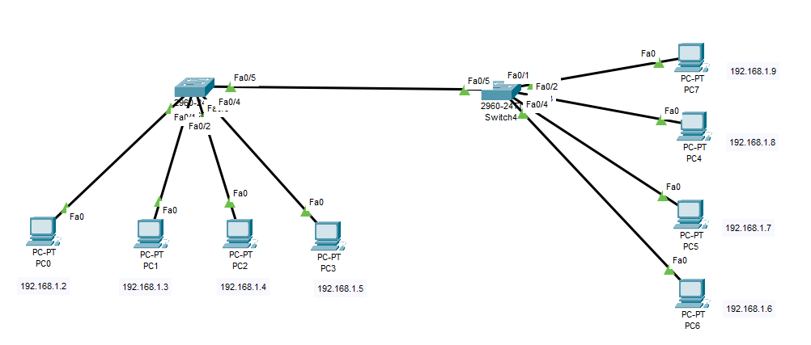
Question:
You have two switches connected via FA 0/5 trunk port.
4 computers on each switch, all connected to VLAN 1 on both switches.
Network IDs: 192.168.1.0 for all computers.
Do I need to configure the trunk port in this scenario?
Answer:
You don’t need to configure trunk on both switches explicitly unless you're using multiple VLANs other than VLAN 1 or other VLANs are required for specific purposes. For VLAN 1, it works by default via the trunk link.

Slide 61
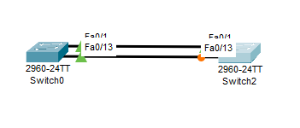
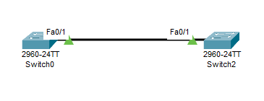
Single Point of Failure: The Need for Backup Links:
Single Point of Failure (SPOF)
A single point of failure is a part of a system or network that, if it stops working, causes the entire system or network to fail.
For example:
In a network, if two switches are connected by a single trunk link and that link fails, communication between the switches will stop.
Backup Link
A backup link is an alternate connection that ensures communication continues if the main link fails.
In networks:
It provides redundancy to avoid downtime.

Slide 62
Problem caused by the Backup Link:
Broadcast Storm:
Broadcast packets, like ARP requests, will keep circulating endlessly between the two switches, consuming bandwidth and overwhelming the network.
MAC Address Table Instability:
Switches will receive the same frames on multiple ports due to the loop, causing constant updates to their MAC address tables, which leads to instability and confusion about which port to use for forwarding frames.
Looping:
Frames will loop endlessly between the switches, making the network unusable and causing delays or outages.

Slide 63
Solution to this problem is “STP”:
Spanning Tree Protocol (STP):
STP is a network protocol that prevents loops in a network with multiple switches. It does this by making sure only one active path exists between switches, while blocking any redundant paths. If the active path fails, STP automatically activates the backup path to keep the network running smoothly.
In short:
STP keeps your network stable and avoids issues like loops, broadcast storms, and unstable connections caused by backup links.
Router# show spanning-tree

Slide 64
STP Process Algorithm:
1. Elect the Root Bridge:
All switches initially assume they are the root bridge.
Each switch sends out a BPDU (Bridge Protocol Data Unit).
The BPDU includes the switch's priority and MAC address. (BPDUs are sent every two seconds
The switch with the lowest priority is elected as the root bridge.
If priorities are equal, the switch with the lowest MAC address becomes the root.
The root bridge manages the Spanning Tree Protocol (STP) process.
2. Determine Root Ports (RP):
After the root bridge is elected, each non-root switch determines its root port (the port that leads to the root bridge).
The root port is the best path towards the root bridge.
Each switch will choose the path with the lowest path cost to the root bridge.

Slide 65
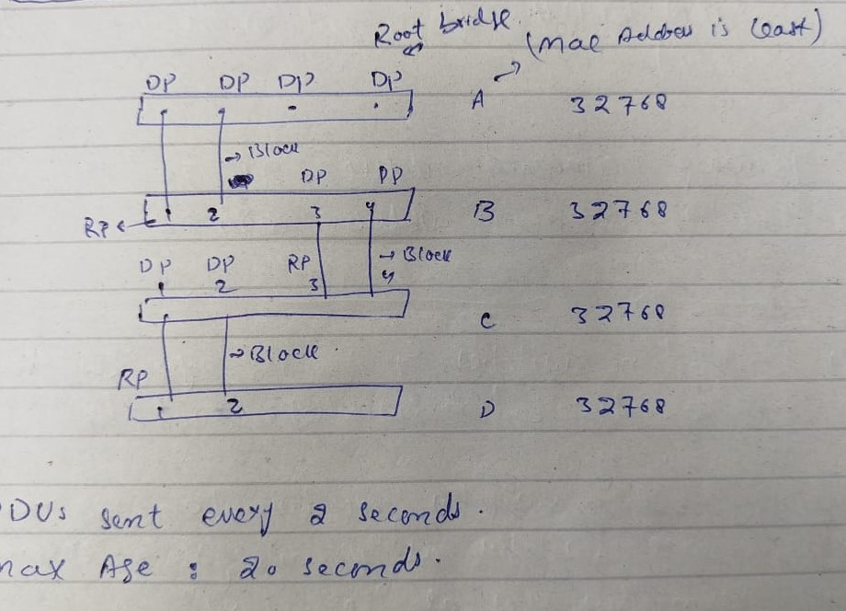
STP Process Algorithm:
3. Designated Port
Designated Port (DP)
The port on each segment with the best path toward the Root Bridge.
4. Blocked Port
A port that is turned off by STP to prevent loops in the network.
It doesn’t send or receive normal traffic.

Slide 66
STP Process Algorithm:
Why does the STP election happen?
Because loops can crash a network.
STP holds an election to choose one main switch (Root Bridge).
Then, all other switches follow it to avoid loops.
BPDUs are sent every 2 seconds
When a switch is down & 10 BPDUs are sent & no response from that down switch the again election will take place among other remaining switches
Think of it like choosing a leader so everyone knows who to follow — and no one goes in circles.
The default priority value on Cisco switches for Spanning Tree Protocol (STP) is: 32768
Bridge ID = Priority + MAC Address

Slide 67
STP Process Algorithm:
🔹 Role of the Root Bridge
Acts as the central reference point in the network.
All path cost calculations in the network are made with respect to the root bridge.
Sends BPDUs from all its ports to other switches.
Helps other switches calculate the best path to reach it.
Does not choose root or designated ports for other switches.
Keeps sending BPDUs to maintain network stability and detect changes..

Slide 68
STP Process Algorithm:
3. Assign Port Roles:
The switches then assign roles to their ports:
Root Port (RP): The best port on a switch towards the Root Bridge.
Designated Port (DP): The best port on a segment away from Root Bridge. (On which computers can be connected)
Blocked Port: Extra links that might cause loops — these are put in blocking state.
4. Calculate Path Cost:
The cost of the path is calculated using the port cost based on the speed of the link (higher-speed links have lower cost).
The switch chooses the port with the lowest total cost to the root bridge as the root port.

Slide 69
STP Process Algorithm:
✅ Note: If both links are of the same quality and cost, then the port with the lowest port number will become the Root Port.
Example:
Between fa0/1 & fa0/2
fa0/1 will be the Root Port.
Between fa0/5 & fa0/6
fa0/5 will be the Root Port.

Slide 70
STP Process Algorithm:
4. Path Cost Calculation Process:
Port Cost Based on Link Speed: Each port on a switch has a default cost based on the bandwidth of the link. The faster the link (higher bandwidth), the lower the cost.
 | Bandwidth | Cost
Ethernet | 10Mbs | 100
Fast Ethernet | 100Mbs | 19 or 20
Gig Ethernet | 1 Gb | 4
10 Gigabit Ethernet (10GbE) | 10 Gbps | 2
100 Gigabit Ethernet (100GbE) | 100 Gbps | 1

Slide 71
STP Process Algorithm:
Preemption is the process where a device, process, or path automatically takes control when it becomes available again
STP has preemption, meaning if the Root Bridge or Root Port goes down, and later comes back up, it will become the Root Bridge or Root Port again

Slide 72
STP Ports State:
1. Disabled
Description: Port is administratively down or not in STP.
Traffic: No traffic sent or received.
Reason: Manually disabled or unused.
2. Blocking
Description: Active port prevents loops by not forwarding traffic.
Traffic: Processes BPDU only.
Reason: Backup or alternative path.
3. Listening
Description: Listens for BPDU to check topology and prevent loops.
Traffic: No user traffic forwarded.
Duration: Temporary during convergence.
4. Learning
Description: The port begins to learn MAC addresses but still does not forward user traffic.
Traffic: Processes BPDU and updates the MAC address table.
Duration: Temporary state during convergence.
5. Forwarding
Description: The port is fully operational and forwards user traffic.
Traffic: Forwards traffic, sends and receives BPDU, and updates the MAC address table.
Reason: Port is part of the active topology.

Slide 73
Types of STP:
PVSTP (Per-VLAN Spanning Tree Protocol):Cisco-only.
One spanning tree for each VLAN.
Better load balancing.
RSTP (Rapid Spanning Tree Protocol):
Faster version of STP.
Quick recovery from network changes.
MSTP (Multiple Spanning Tree Protocol):
Groups multiple VLANs into one spanning tree.
Efficient for large networks.

Slide 74
PVSTP (Per-VLAN Spanning Tree Protocol):
Imagine you have a network with 3 VLANs (VLAN 10, VLAN 20, VLAN 30) connected to multiple switches. With PVSTP:
Each VLAN gets its own spanning tree.
VLAN 10 could have one root bridge, VLAN 20 could have a different root bridge, and VLAN 30 a third one.
This allows the network to manage each VLAN separately, improving performance and load balancing.
Example Scenario:
VLAN 10: If Switch A has the lowest Bridge ID for VLAN 10, it will be the root bridge for that VLAN.
Other switches (Switch B, Switch C) will learn about Switch A as the root bridge for VLAN 10 and will adjust their paths accordingly.
VLAN 20: If Switch B has the lowest Bridge ID for VLAN 20, it will be the root bridge for that VLAN, while Switch A and Switch C will recognize it as the root bridge for VLAN 20.
VLAN 30: If Switch C has the lowest Bridge ID for VLAN 30, it will be the root bridge for that VLAN, while the other switches will learn that Switch C is the root for VLAN 30.

Slide 75
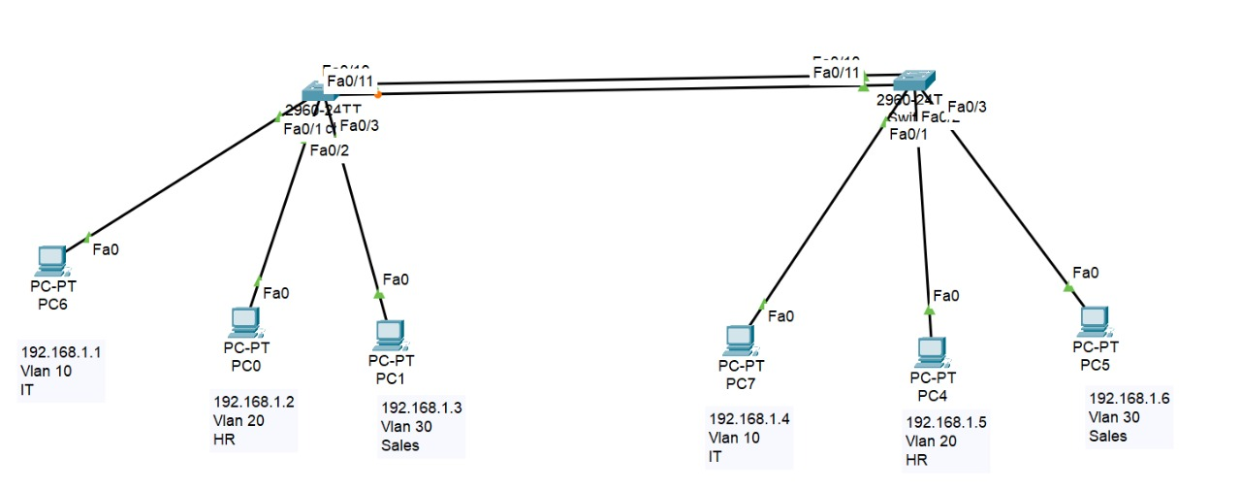
PVSTP (Per-VLAN Spanning Tree Protocol):
Practical:
fa0/10
fa0/11
fa0/10
fa0/11

Slide 76
PVSTP (Per-VLAN Spanning Tree Protocol):
Practical:
Switch A
switch(config)# vlan 10
switch(config-vlan)# name IT
switch(config-vlan)# exit
switch(config)# vlan 20
switch(config-vlan)# name HR
switch(config-vlan)# exit
switch(config)# vlan 30
switch(config-vlan)# name Sales
switch(config-vlan)# exit
switch(config)# interface fa 0/1
switch(config-if)# switchport mode access
switch(config-if)# switchport access vlan 10
switch(config-if)# exit
switch(config)# interface fa 0/2
switch(config-if)# switchport mode access
switch(config-if)# switchport access vlan 20
switch(config-if)# exit
switch(config)# interface fa 0/3
switch(config-if)# switchport mode access
switch(config-if)# switchport access vlan 30
switch(config-if)# exit
Switch B
switch(config)# vlan 10
switch(config-vlan)# name IT
switch(config-vlan)# exit
switch(config)# vlan 20
switch(config-vlan)# name HR
switch(config-vlan)# exit
switch(config)# vlan 30
switch(config-vlan)# name Sales
switch(config-vlan)# exit
switch(config)# interface fa 0/1
switch(config-if)# switchport mode access
switch(config-if)# switchport access vlan 10
switch(config-if)# exit
switch(config)# interface fa 0/2
switch(config-if)# switchport mode access
switch(config-if)# switchport access vlan 20
switch(config-if)# exit
switch(config)# interface fa 0/3
switch(config-if)# switchport mode access
switch(config-if)# switchport access vlan 30
switch(config-if)# exit
Trunking protocol
switch(config)# interface fa 0/10
switch(config-if)# switchport mode trunk
switch(config-if)# exit
switch(config)# interface fa 0/11
switch(config-if)# switchport mode trunk
switch(config-if)# exit
Result:
#show spanning-tree

Slide 77
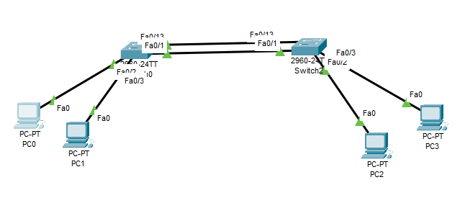
PVSTP (Per-VLAN Spanning Tree Protocol):
Switch# show spanning-tree
In the root bridge, only the root bridge information will be displayed (including the root ID and bridge ID).
In non-root bridges, the root ID will show the root bridge information, while the bridge ID will display the non-root bridge's information.
Switch A
Switch B

Slide 78
PVSTP (Per-VLAN Spanning Tree Protocol):
To Make Switch-A a root bridge manually by priority:
SwitchA(config)# spanning-tree vlan 1 priority 28672
Or
SwitchA(config)# spanning-tree vlan 1 root primary
This command will automatically set the lowest priority
Switch A
Switch B
To make Switch A the root bridge for VLAN 10, VLAN 20, and VLAN 30, you can use the following commands:
SwitchA(config)# spanning-tree vlan 10 priority 28672
SwitchA(config)# spanning-tree vlan 20 priority 28672
SwitchA(config)# spanning-tree vlan 30 priority 28672

Slide 79
PVSTP (Per-VLAN Spanning Tree Protocol):
You change the root bridge to control the path that traffic takes for performance, load balancing, and stability.
Example:
You have two switches (A and B) connected by two trunk links and have multiple VLANs.
VLAN 10 (IT)
VLAN 20 (HR)
VLAN 30 (Sales)
By default, one of the switches (e.g., Switch B) may become the root for all VLANs — because it happens to have the lowest Bridge ID.
That means:
All VLANs will forward traffic through Switch B, and Switch A will block one of its ports for all VLANs.
So → only one link is active, the other is blocked for all VLANs.
Why we change it?
If you manually make Switch A the root for VLAN 10,and Switch B the root for VLAN 20.
VLAN 10 will use link 1 (e.g., Fa0/10)
VLAN 20 will use link 2 (e.g., Fa0/11)
➡️ Result: Both trunk links are active — traffic load is shared. This is called STP load balancing.
Will it create loop ?
No — it will not create a loop, because each VLAN’s STP instance still makes sure there’s only one active path per VLAN.

Slide 80
RSTP (Rapid Spanning Tree Protocol):
Rapid Spanning Tree Protocol (RSTP)
RSTP is an improved version of STP (Spanning Tree Protocol).
It provides faster network recovery when a link or switch fails.
Traditional STP takes 30–50 seconds to recover.
RSTP recovers in just 1–2 seconds.
It quickly activates backup paths, reducing downtime.
Ensures traffic is rerouted efficiently.
Example:
Without RSTP: STP takes 30-50 seconds to recover if the root switch fails.
With RSTP: Traffic is rerouted in 1-2 seconds for fast recovery.
Advantages of RSTP for Trunk Links:
Faster Recovery: Trunk link failures are detected and recovered in seconds.
Improved Redundancy: Alternate paths for trunk links are quickly activated.
Minimized Downtime: Traffic rerouted faster, ensuring continuous network connectivity.

Slide 81
RSTP (Rapid Spanning Tree Protocol):
RSTP is used for faster trunk link ports:
SwitchA(config)#spanning-tree mode rapid-pvst
SwitchB(config)#spanning-tree mode rapid-pvst
To enable Port Fast on trunk links, you need to configure it on both sides. i.e. SwitchA and SwitchB
******************************************************************************************************************
To enable PortFast on an access port:
Switch(config)# spanning-tree portfast default
It is used to globally enable PortFast on all access ports on the switch.

Slide 82
Ether Channel:
The logical combination of two or more than two trunk links into a single logical link to increase bandwidth and provide redundancy is called Ether Channel
Conditions for Configuring EtherChannel:
Port Speed: The speed of the ports must match on both sides of the link.
Allowed VLANs: The VLANs allowed on the trunks must be the same on both switches.
Duplex: The duplex settings must match on both sides.
Protocol: Protocol must be same on both sides (either LACP or PAgP)

Slide 83
Protocols in EtherChannel:
There are two types of protocols used in EtherChannel:
PAgP (Port Aggregation Protocol)
LACP (Link Aggregation Control Protocol).
PAgP | LACP
Cisco Proprietary: Supported only on Cisco devices. | Open Standard: Supported by multiple vendors.
Maximum Ports: Can combine up to 8 physical ports into a single EtherChannel. | Maximum Ports: Can combine up to 16 physical ports into a single EtherChannel, but only 8 are active at a time, while the rest remain in standby.
Mode: Desirable :Actively sends and receives PAgP packets. Auto: Only listens for PAgP packets but does not actively send them. | Modes: Active: Actively sends and receives LACP packets. Passive: Only listens for LACP packets but does not actively send them.

Slide 84
Protocols in EtherChannel:
PAgP Mode Combinations and Ether Channel Formation
Mode Combination | Ether Channel Formation
Desirable ↔ Desirable | EtherChannel
Desirable ↔ Auto | EtherChannel
Auto ↔ Auto | No EtherChannel
Best Situation is Desirable ↔ Desirable
LACP Mode Combinations and Ether Channel Formation
Mode Combination | Ether Channel Formation
Active ↔ Active | EtherChannel
Active ↔ Passive | EtherChannel
Passive ↔ Passive | No EtherChannel
Best Situation is Active ↔ Active

Slide 85
Protocols in EtherChannel:
Desirable Desirable ✅ Works, Both sides actively send LACP packets.
Desirable Auto ✅ Works, One side initiates, the other responds.
Auto Auto ❌ Fails, Both are waiting — no one starts negotiation.
Active Active ✅ Works, Both sides actively send LACP packets.
Active Passive ✅ Works, One side initiates, the other responds.
Passive Passive ❌ Fails, Both are waiting — no one starts negotiation.

Slide 86
Example Working of Ether Channel:
Practical Example:
10 computers on Switch A and 10 computers on Switch B, all communicating simultaneously.
With EtherChannel (3 links at 100 Mbps each):
  Each flow (e.g., a file transfer between Computer 1 and Computer 2) uses one link.
  Different flows can use different links, effectively utilizing the combined 300 Mbps bandwidth.
Without EtherChannel:
All flows are forced to share a single 100 Mbps link, creating congestion and slower performance.
In a traditional setup with multiple links between two switches, STP will block redundant links to prevent loops. With EtherChannel, STP treats all links in the EtherChannel as one logical link, so no links are blocked. This means you can use the full capacity of all the links.

Slide 87
Example Working of Ether Channel:
When you're using EtherChannel, all the bundled links (e.g., 3 links) are treated as one logical link by STP.
🔹 Here’s what happens:
STP does not block individual links inside an EtherChannel.
Instead, it sees all links in the EtherChannel as a single connection.
So, all 3 links are active and used for traffic (no blocking among them).
✅Traffic will go over all 3 links in the EtherChannel — none of them will be in a blocked state.
🔁 Normally (Without EtherChannel):
STP blocks redundant (backup) links to prevent loops.
Only one active path is allowed between switches.
The backup link stays in Blocking State until it's needed (e.g., if the active link fails).
🔀 But with EtherChannel:
All physical links are bundled into one logical link.
STP sees it as a single link, so it doesn’t block individual links inside it.
All links stay active and share the traffic — no blocking within the EtherChannel.

Slide 88
Example Working of Ether Channel:
No loop , No storming , No Mac Address Instability
You create EtherChannel (example: Port-channel1).
switches, treat these 3 cables as one single big pipe.
STP sees only ONE logical link (Port-channel1), not 3.
✅ All 3 cables are active ✅ No loops ✅ Full bandwidth is used
🧮 How traffic actually flows
Inside EtherChannel: Each frame is sent only through one cable — chosen by a hashing algorithm (like based on MAC or IP).
Frame 1 → Cable 1 , Frame 2 → Cable 2, Frame 3 → Cable 3
No frame is ever copied on all 3 cables — so no looping or storming happens.
🧱 Why MAC address table stays stable
All 3 cables act as one single interface (Port-channel1), so the switch learns:
PC1’s MAC → Port-channel1

Slide 89
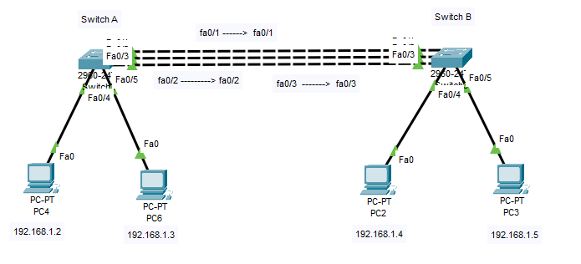
PAgP Lab Practical :
On Switch A:
switch> enable
switch# configure terminal
switch(config)# interface range fa0/1, fa0/2, fa0/3
switch(config-if-range)# channel-group 2 mode desirable
On Switch B:
switch> enable
switch# configure terminal
switch(config)# interface range fa0/1, fa0/2, fa0/3
switch(config-if-range)# channel-group 2 mode desirable
Result:
switch# show etherchannel summary

Slide 90
LACP Lab Practical:
On Switch A:
switch> enable
switch# configure terminal
switch(config)# interface range fa0/1, fa0/2, fa0/3
switch(config-if-range)# channel-group 2 mode active
On Switch B:
switch> enable
switch# configure terminal
switch(config)# interface range fa0/1, fa0/2, fa0/3
switch(config-if-range)# channel-group 2 mode active
Result:
switch# show etherchannel summary

Slide 91
CISCO Wireless Architecture and AP Modes
Cisco's wireless architecture provides secure, scalable, and high-performance wireless networking. Key components include:
Wireless LAN Controller (WLC): Central device managing multiple access points (APs) for tasks like RF management, security, and policies.
Access Points (APs): Devices providing wireless connectivity, either lightweight (controlled by WLC) or autonomous (functioning independently).
Wireless Clients: Devices that connect to the network, such as laptops and smartphones.
Wireless Security: Includes WPA2/WPA3, 802.1X, and access control methods.
Prime Infrastructure (PI): Platform for monitoring and managing wireless networks.
FlexConnect: Enables APs to operate locally in remote offices, improving performance.
Cisco DNA Center: Centralized management for both wired and wireless networks, ensuring automation, security, and monitoring.

Slide 92
CISCO Wireless Architecture and AP Modes
AP Modes:
Mode | Description
Lightweight Mode | APs managed by WLC, suitable for large enterprise networks.
Autonomous Mode | APs operate independently, no reliance on WLC. Ideal for small networks.
Mesh Mode | APs create a mesh network for extended coverage without wired backhaul.
Monitor Mode | APs listen for wireless traffic and interference; used for monitoring.
Sniffer Mode | APs capture and analyze wireless network traffic for troubleshooting.
FlexConnect Mode | APs can handle some local traffic while still being centrally managed.
WGB Mode | APs bridge wireless and wired networks, extending coverage.

Slide 93
Some CISCO latest APs:
AP Type | Use Case | Antenna | Latest Models
Catalyst Access Points | High-performance, enterprise environments | Internal or external antennas | Catalyst 9100 Series
Cloud-Managed Access Points | Small to medium businesses, cloud-based | Internal (some external options) | Meraki APs
Aironet Access Points | High-density enterprise environments | Internal & external antennas | Aironet 1800, 2800, 3800 Series
Outdoor & Industrial APs | Outdoor and harsh industrial environments | High-gain or omnidirectional antennas | Cisco Industrial APs
Small Business Access Points | Cost-effective for small businesses | Internal omnidirectional antennas | Business 100 and 200 Series

Slide 94
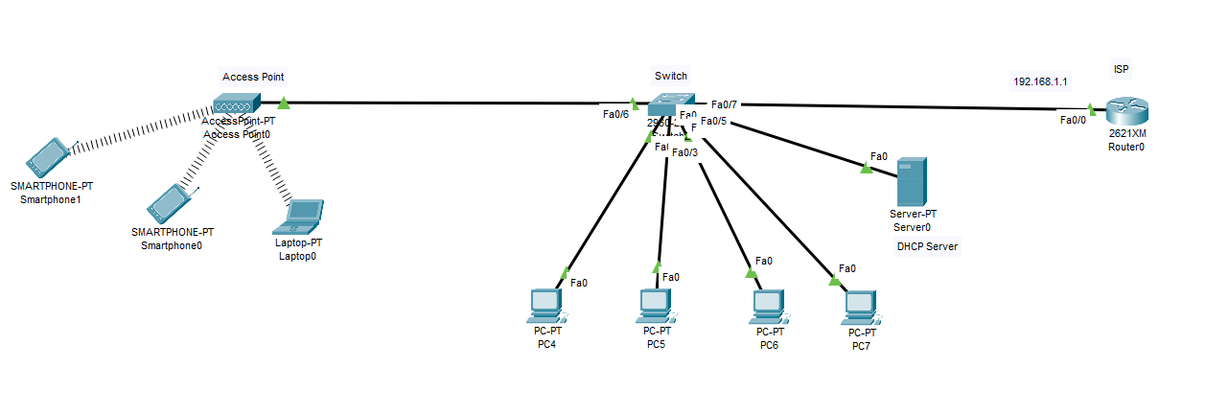
Connecting Smart Devices and Computers to the Network via Access Point:

Slide 95
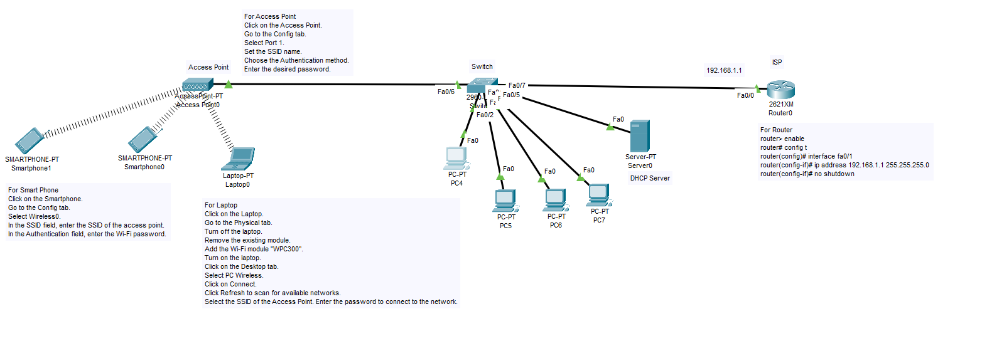
Connecting Smart Devices and Computers to the Network via Access Point:

Slide 96
Connecting Smart Devices and Computers to the Network via Access Point:
Router
router> enable
router# config t
router(config)# interface fa0/1
router(config-if)# ip address 192.168.1.1 255.255.255.0
router(config-if)# no shutdown
Smart Phone
Click on the Smartphone.
Go to the Config tab.
Select Wireless0.
In the SSID field, enter the SSID of the access point.
In the Authentication field, enter the Wi-Fi password.
DHCP Server
Will assign IPs to the devices
Laptop Configuration
Click on the Laptop.
Go to the Physical tab.
Turn off the laptop.
Remove the existing module.
Add the Wi-Fi module "WPC300".
Turn on the laptop.
Click on the Desktop tab.
Select PC Wireless.
Click on Connect.
Click Refresh to scan for available networks.
Select the SSID of the Access Point.
Enter the password to connect to the network.
Access Point
Click on the Access Point.
Go to the Config tab.
Select Port 1.
Set the SSID name.
Choose the Authentication method.
Enter the desired password.

Slide 97
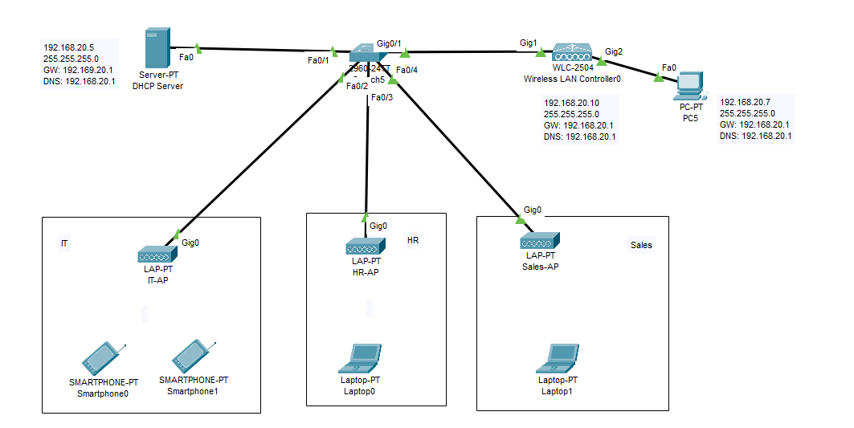
Configuration of Wireless LAN Controller and AP Using GUI

Slide 98
Configuration of Wireless LAN Controller and AP Using GUI
First Step:
You need:
WLC
APs
DHCP Server for IP assignment
Switch for centralized network
Computer for management
End devices connected to the APs
Third Step:
Click on the AP.
    Click on “Physical” in the menu.
Drag the Access Point Power Adapter towards the AP to turn it on.
Click on “Config” in the menu.
Click on “Settings” and select DHCP.
Second Step:
Click on the WLC.
Click on “Config” in the menu.
Click on “Management” and assign the IPs:
IP: 192.168.20.10
Subnet Mask: 255.255.255.0
Gateway: 192.168.20.1
DNS: 192.168.20.1
Click on the computer.
  Assign the IPs:
  IP: 192.168.20.7
  Subnet Mask: 255.255.255.0
  Gateway: 192.168.20.1
  DNS: 192.168.20.1
Click on the DHCP Server.
        Create an IP Pool:
  Gateway: 192.168.20.1
  DNS: 192.168.20.1
  Start IP: 192.168.20.101
  WLC Address: 192.168.20.1
Now:
Click on the PC again.
Click on “Web Browser.”
In the URL field, type: https://192.168.20.10 (this time using HTTPS).

Slide 99
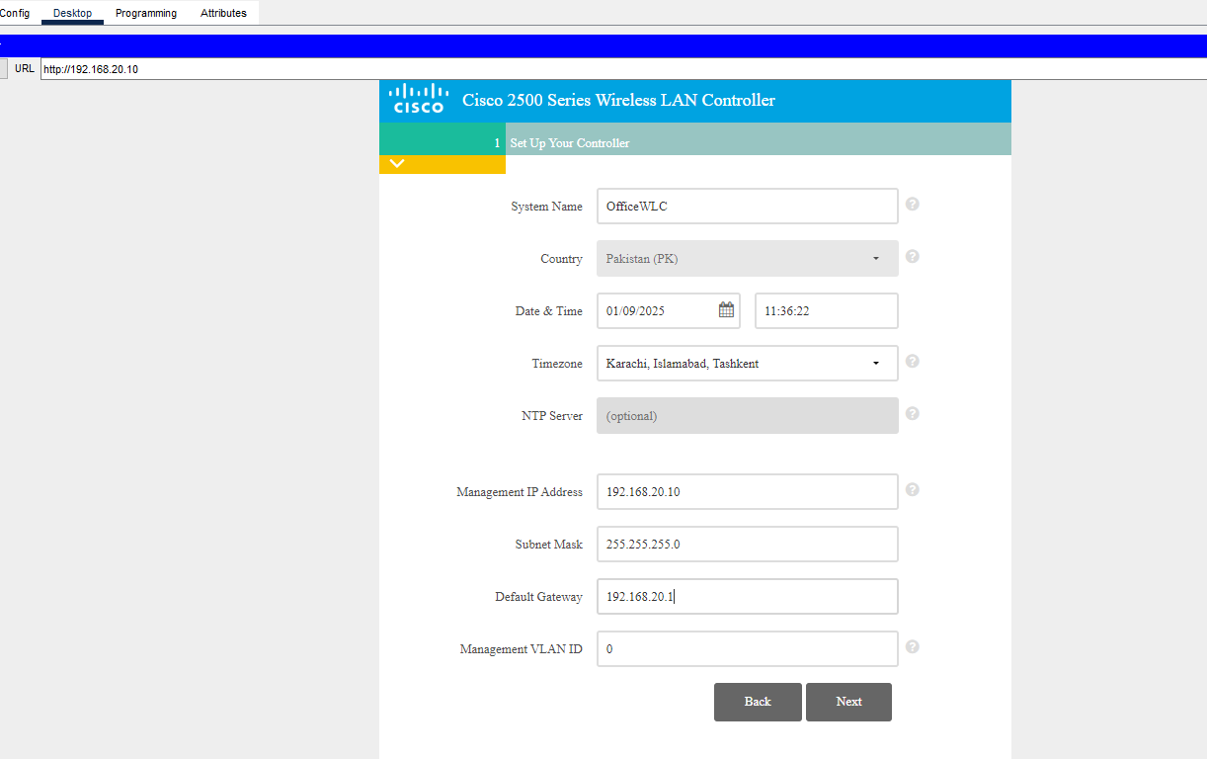
Configuration of Wireless LAN Controller and AP Using GUI
Now:
Click on the PC again.
Click on “Web Browser.”
In the URL field, type: https://192.168.20.10 (this time using HTTPS)
Enter the details and click "Next.“.

Slide 100
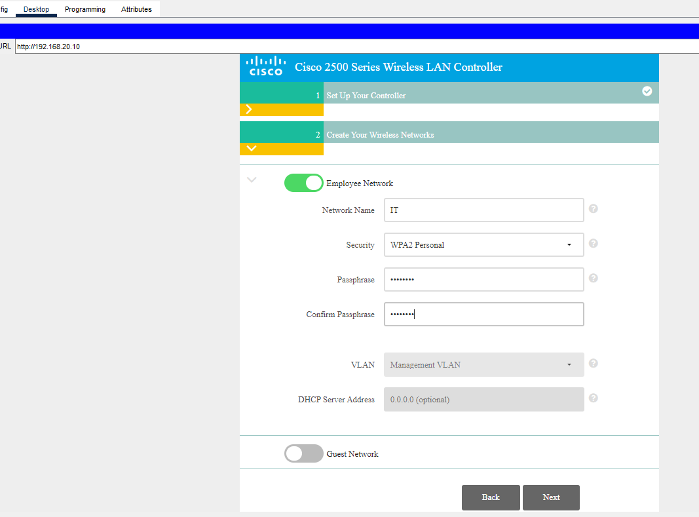
Configuration of Wireless LAN Controller and AP Using GUI
Enter the details and click "Next.“

Slide 101
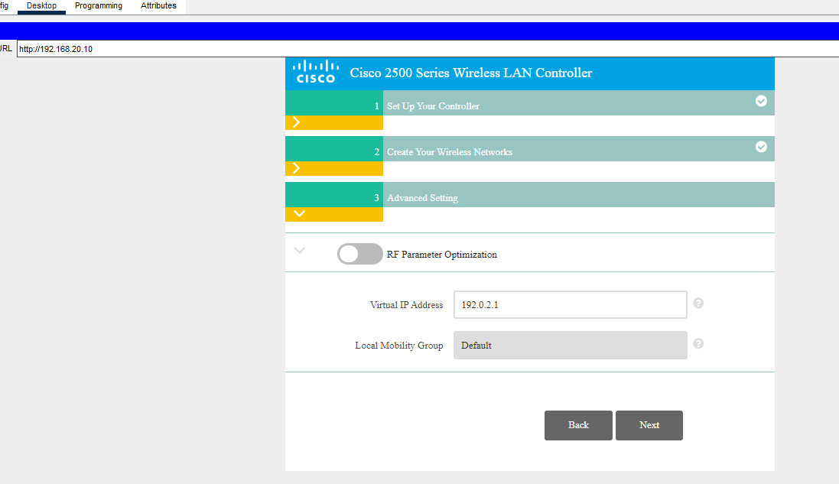
Configuration of Wireless LAN Controller and AP Using GUI
Click "Next" again, and then click "Apply."

